Slide 1
(DO NOT SHOW) Micrsoft Azure Enterprise Deck
Current scope:
Microsoft Azure General Overview
Title:
Microsoft Azure - “Bringing Cloud to your Enterprise”
Audience:
Enterprise IT Leaders, IT DMs
Length:
45-60 minutes (Customize as necessary depending on audience)
Content Level:
Level 200 for external & internal use (Non-NDA)
Deck Contacts:
Tony Meleg; Anusha Rangaswamy(Send any suggested edits or inaccuracies)
Date Updated:
January 2015
Desired Outcomes:
Customer understands Microsoft Azure value prop, common use cases.
Usage Guide:
DO NOT edit slides or text
This deck should be used for the first discussion on Azure to set context. Do not start with feature decks.
Demo’s – Leverage http://demomonkey.cloudapp.net
Translation of content is allowed
Augment content with local customer stories
Deck is OK to send to customers but REMOVE SPEAKER NOTES

Slide 2
Microsoft Azure Bringing Cloud to your Enterprise

Slide 3
Why consider the cloud?
Public Cloud Platform
$30
Speed
Scale
Economics
$25
$20
Market Share (in Billions)
$15
$10
$5
2008
2009
2010
2011
2012
2013
2014
2015
2016
2017
2018
2019
2020
Notes:
In the last few years, we have seen an explosive growth in the use of the public cloud. While most of the initial adoption was seen by startups and smaller orgs, most of the new growth will come from larger organizations adopting the public cloud.
Now you might ask what’s causing cloud adoption at such a fierce rate. There are 3 fundamentals business drivers at play here:
SPEED: With minutes instead of days/weeks to procure & provision servers, the pace of innovation has dramatically increased. Reduced ‘time to develop’ & ‘time to market’ means your IT can be much more agile in servicing needs of the business units or developers. Embrace & Enable Innovation. Help your business move forward against the competition. In fact, it is the speed and agility that IT hasn’t been able to provide has resulted in what many call “Shadow IT” where business units are resorting to using credit cards to procure computing resources outside of the purview of the IT.
SCALE: Cloud gives you an almost infinite set of computing resources. Your applications will enjoy massive global scale, and can easily scale up or down depending on the demand. That means, you never have to worry about running out of capacity or worry about overprovisioning. You use just enough resources for your needs - nothing more, nothing less.
ECONOMICS: And of course, you’re paying only for what you use in the Cloud. This in itself saves you money for any app that has variable computing needs. For some organizations, there is also an additional benefit of changing CapEX to OpEX, which frees up capital from infrastructure investments so it can be put to other uses.

Slide 4
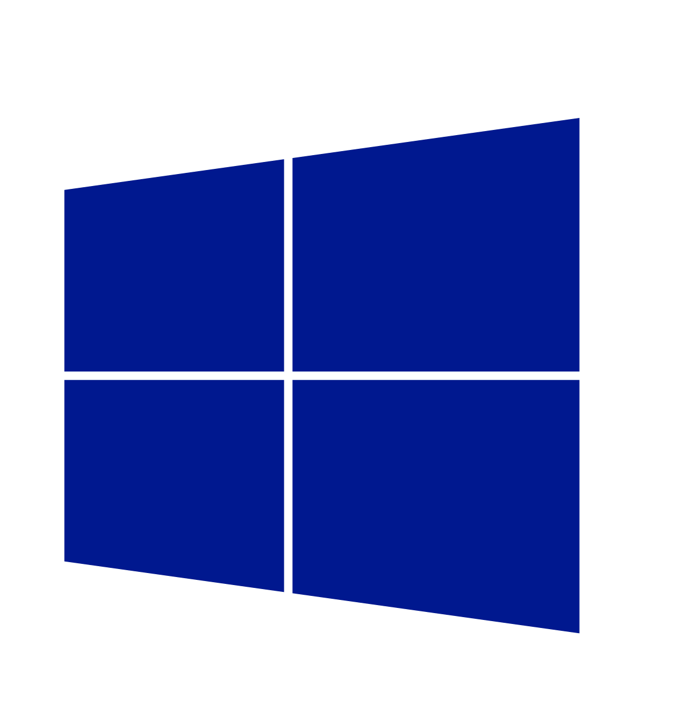
Cloud innovation presents challenges for IT
How do I integrate with my existing IT investments?
What about my heterogeneous, complex IT landscape?
What about security and compliance?
Notes:
But as you think about using the public cloud, there are some top of mind issues you have to reckon with.
If you’re like most organizations, you have your existing servers and IT infrastructure (either on-premises in your own datacenters or in 3rd part colocation facilities). You also have an IT staff to manage these assets. So as you think about using the public cloud, you’re not thinking of it in a silo – ideally where possible you’d want to integrate the public cloud with existing IT, manage it no differently, and even have applications with parts running on and off-premises. Latest IDC findings show 40% of enterprises are already adopting hybrid clouds today (source - http://www.infosys.com/newsroom/press-releases/Pages/cloud-ecosystem-integrator.aspx).
You’re also probably running a variety of OSs, databases, middleware and toolsets from multiple IT vendors. Your developers are proficient in multiple languages and your apps are written in multiple languages and frameworks. In other words, your IT environment is complex and heterogeneous. And you want to make sure the cloud you choose is able to handle your heterogeneous needs.
Next you have to abide by a bunch of security and compliance initiatives. The rest of the business trusts your IT org to run apps in a secure and reliable manner. So you want to make sure the public cloud platform and the vendor who provides the service is using is trustworthy, i.e. has the right experience and expertise, and has necessary SLAs, and security controls in place.

Slide 5
Enterprise needs
Integration
Heterogeneity
Security
On-premises and Cloud
Broad and flexible
Secure and reliable
Notes:
Let’s see what you as enterprise customers uniquely expect from a public cloud platform. These are “must haves”:
Integration – So you can integrate with your existing apps and infrastructure.
Heterogeneity - So you can continue to support multiple languages, frameworks, OSs
Security – So you continue to run your enterprise apps securely and reliably
Windows Azure, our public cloud offering, addresses these needs. Windows Azure is built on three core fundamentals:

Slide 6
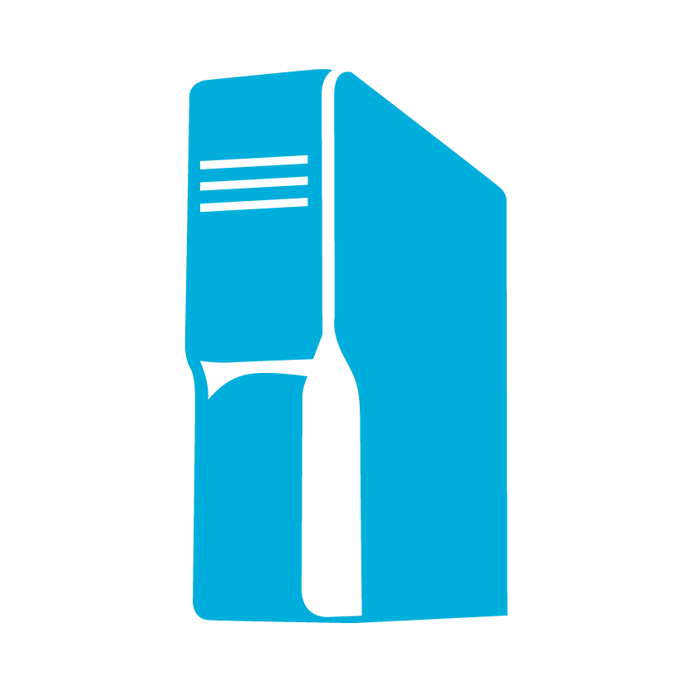
Enterprise needs
Virtualization
Integration
Identity
Data
Platform
On-premises
Cloud
Microsoft Azure fundamentals
On-premises AND Cloud
Development
DevOps and mgmt
Notes:
On-premises AND Cloud: We believe in a world where you’re integrating public cloud with your on-premises infrastructure, and using each where it makes sense, in conjunction with each other. Think and, not or. It’s not an on-premises OR cloud proposition – it’s an AND proposition. And when we say integration, we mean true integration – across infrastructure, apps, identity, and databases. This is what we call hybrid.
Microsoft is the only company which has the necessary assets across virtualization, identity, data platform , development and management to provide a consistent experiences across on-premises, our cloud and 3rd party service providers. This vision and strategy - called “Cloud OS” – is what we aim to deliver for our customers. If you choose look at other Cloud vendors that provide public OR private cloud offerings (Amazon, VMware, or Google), you have to cobble together disparate offerings and you will not get a seamless experience.

Slide 7





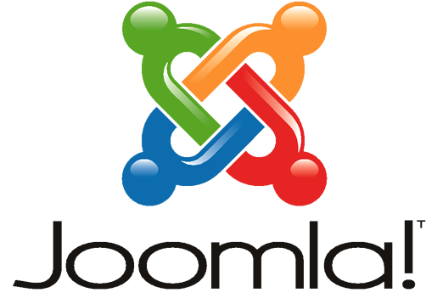
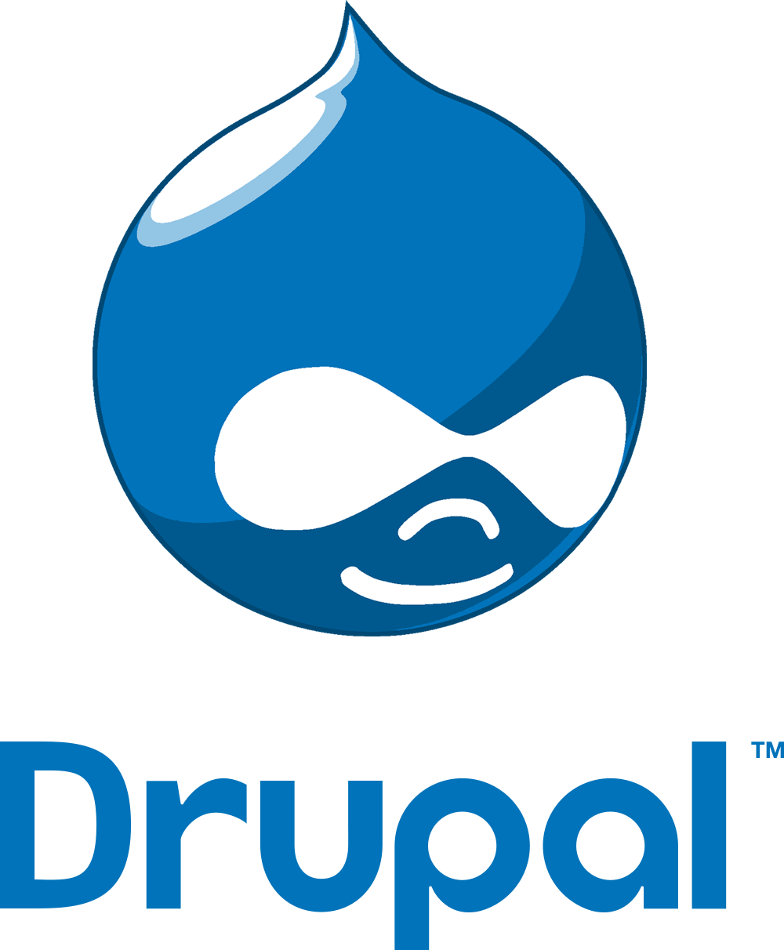





Enterprise needs
Heterogeneity
Integration
Languages
CMS
Devices
Databases
Microsoft Azure fundamentals
Operating
Systems
Open, Broad
and Flexible
On-premises AND Cloud
Notes:
Open, Broad and flexible: We realize that you’ll want to run a variety of workloads in the cloud. In Windows Azure, we will of course provide first and best experience and support for Microsoft workloads, but at the same time we have embraced other open technologies so you get a cloud experience that satisfies your heterogeneous needs.
In enterprises, Java and .NET are still most used, but developers are also using PHP, Python and other languages in addition. Windows Azure supports all these languages and more.
Windows Azure provides out-of-the box experience for open frameworks like Hadoop, web frameworks like Wordpress, Joomla and Drupal. We also provide first party SDKs for developing apps using Android, IOS or Windows phones.
We not only support, but have embraced open technologies.
We also provide a broad set of services that provide you a good choice. In addition to the breadth of the platform, it’s important to note that using Windows Azure is not an all or nothing proposition. You can use most services independently of each other. For example, you can just use storage without compute or use DB without using storage. What you want to use and how you want to use is really YOUR choice.

Slide 8
Enterprise needs
Heterogeneity
TRANSPARENCY
Security
Languages
CMS
Devices
Databases
Microsoft Azure fundamentals
Operating
Systems
Open, Broad and Flexible
Trustworthy
Notes:
As you take the journey into the Cloud, you need a secure and trustworthy platform. And you need someone who’s committed to the Cloud.
Let’s talk about the three things that makes Windows Azure and Microsoft a trustworthy platform: Transparency, Relationship and Experience

Slide 9
TRANSPARENCY
Enterprise needs
RELATIONSHIP
EXPERIENCE
Security
Trust through transparency
ISO 27001 Cloud Security Alliance (STAR)
Industry standards
Regulatory compliance
Trust center
$
Monthly SLAs
Yearly audits
Independently verified
Real-time status
Service dashboard
Microsoft Azure fundamentals
Trustworthy
Notes:
We believe in Trust through Transparency. We are transparent in the following ways:
We participate in industry standards like ISO 27001, SSAE16 and Cloud Security Alliance.
We undertake yearly audits with independent 3rd parties
We provide a rich set of financially backed monthly SLAs (this differentiates us from other cloud providers like AMZN whose SLAs are fewer and annual). Monthly SLAs are more stringent with less room for error than yealy SLAs
All of our regulatory compliance and privacy policies are clearly explained in the online portal called Trust Center
We provide real time status of all the services via a Service Dashboard. We provide Root Cause Analyses in case of issues.

Slide 10
Enterprise needs
TRANSPARENCY
RELATIONSHIP
EXPERIENCE
Security
Count on your existing relationship
Attach to your EA
Enterprise ready procurement
24x7x365
Enterprise-ready support
MCS, CSS, Partners
Trusted advisors
Microsoft Azure fundamentals
Trustworthy
Notes:
With Microsoft and Windows Azure, you’re relying on you existing relationship and account team to procure and get support.
Azure can be a part of you existing Enterprise Agreement you have in place with Microsoft. This way, you don’t have to negotiate and sign up for yet another agreement with another vendor.
We support Azure and other Microsoft software that you use just the same way. When you run Microsoft workloads on other cloud platforms, you might not get the same level of support. You’ll be relying on a single point of support for you infrastructure and software with Microsoft and Windows Azure
We have an Azure practice in MCS, and continue to be your trusted advisors as you start your journey with the Cloud.

Slide 11
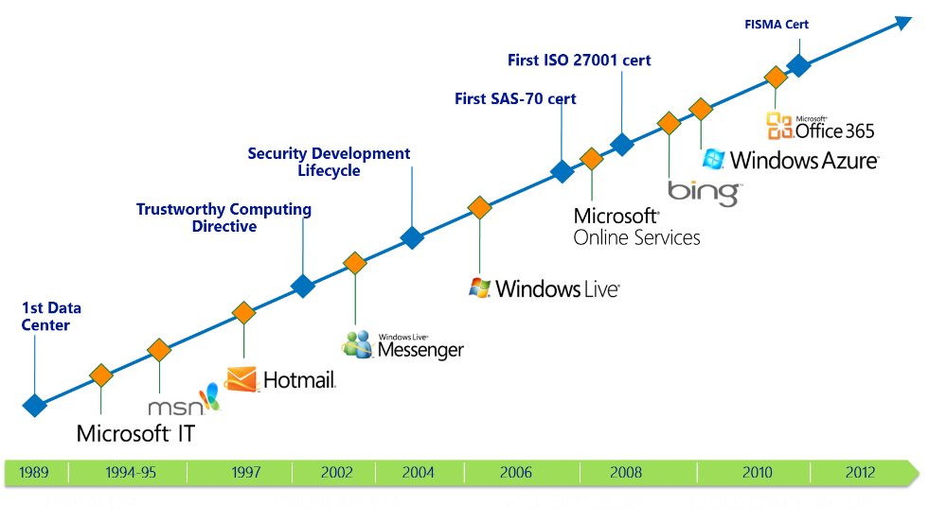
Enterprise needs
TRANSPARENCY
RELATIONSHIP
EXPERIENCE
Security
Unparalleled experience in online security
Microsoft Azure fundamentals
Today, we manage 200+ global services, running 24x7
9.9 billion messages a day via Windows Live Messenger
600 million unique users monthly on Windows Live and MSN
1 Petabyte+ of updates served monthly Windows Update
5M LiveMeeting conference minutes per year
200 billion+ authentications through Windows Azure AD
Trustworthy
Notes:
Windows Azure is not our first foray into Cloud Computing. We have been doing this for more than two decades, and have the deepest experience in the industry.
Our first datacenter was in 1989. Since then, we have run some of the largest global services securely and efficiently – Bing, Office 365 and Hotmail just to name a few.
Today, we run over 200+ global services 24x7 and here are some stats to show you how large scale and global our operations are.
Windows Azure is operated in the same manner by the same teams as some of these other global services. You can rest assure that security and operational efficiency is at our core.

Slide 12
Microsoft Azure delivers.
Enterprise ready by design.
Integration
Heterogeneity
Security
On-premises
AND cloud
Open, Broad, Flexible
Trustworthy
On-premises and Cloud
Broad and flexible
Secure and reliable
WHAT IS AZURE..?
Notes:
Let’s pause and summarize the design principles that make Windows Azure a true enterprise ready platform.

Slide 13

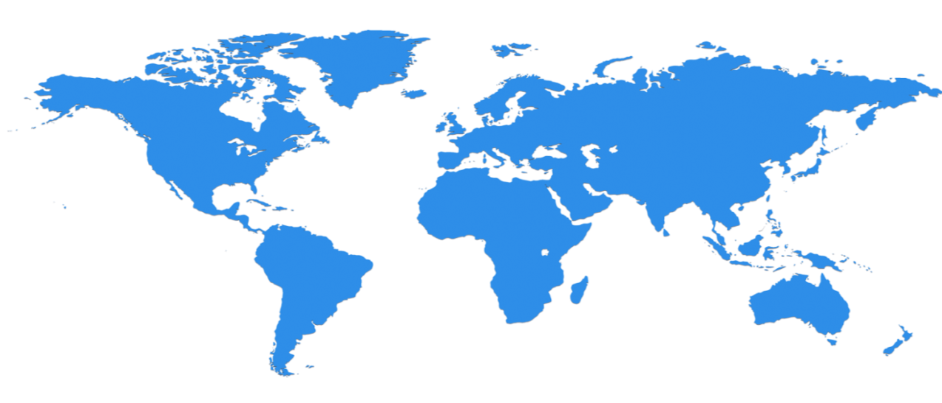

Huge infrastructure scale is the enabler
19 Regions ONLINE…huge datacenter capacity around the world…and we’re growing
North Europe
Ireland
West Europe
Netherlands
Central US
Iowa
North Central US
Illinois
US Gov
Iowa
China North *
Beijing
East US
Virginia
Japan East
Saitama
West US
California
China South *
Shanghai
East US 2
Virginia
Japan West
Osaka
India West
TBD
India East
TBD
South Central US
Texas
US Gov
Virginia
East Asia
Hong Kong
SE Asia
Singapore
Australia East
Sydney
Brazil South
Sao Paulo
100+ datacenters
One of the top 3 networks in the world (coverage, speed, connections)
2 x AWS and 6x Google number of offered regions
G Series – Largest VM available in the market – 32 cores, 448GB Ram, SSD…
Australia West
Melbourne
Operational
Announced
* Operated by 21Vianet
Notes:
Over the last few years we’ve truly delivered a huge infrastructure to enable us to grow our services at scale around the globe. Whether it’s our flagship facilities in Quincy, Washington or Boydton, Virginia, or some of the newly announced facilities in Shanghai, Australia and Brazil, it really is key for us to make smart investments around the world to deliver services in a resilient and reliable fashion.
A lot of people ask, what goes into site selection at Microsoft and how do we decide where to place our datacenter investments? There are over thirty-five factors in our site selection criteria. But really, the top elements are around proximity to customers and energy and fiber infrastructure, insuring that we have the capacity and the growth platforms to be able to grow our services.
Another key element is about skilled workforce. We need to insure that we have the right people to run and operate our datacenters on a day to day basis.

Slide 14
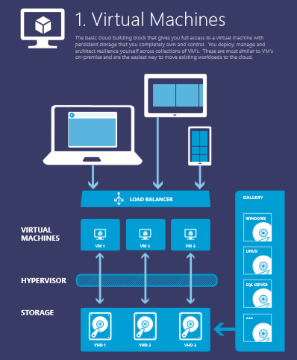
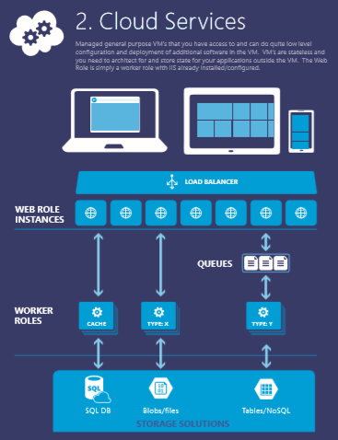
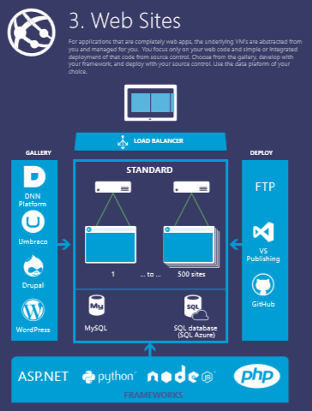
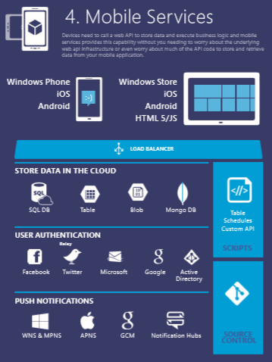
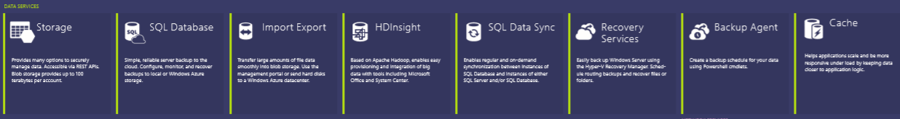



Notes:
You can use this to explain all the Azure building blocks – the compute services at the top and then the other blocks of services – data, networking, Apps…. OR you can go with the next set of slides… YOUR CHOICE…

Slide 15























^{app} ^{services}
cloud services
caching
identity
service bus
media
mobile services
web sites
integration
hpc
analytics
^{data} ^{services}
SQL database
HDInsight
table
blob storage
^{infrastructure} ^{services}
virtual machines
virtual network
vpn
traffic manager
cdn
Notes:
Windows Azure is a broad stack of services that runs in our datacenters globally.
Think of the different services as building blocks. These services can be categorized into three classes –
Infrastructure services which are lower level building blocks,
Data services that provide storage and data management capabilities to apps, and
App services which provide different capabilities to rapidly develop apps, scale and run apps at a global scale.

Slide 16
^{app} ^{services}
cloud services
caching
identity
service bus
media
Apps
mobile services
web sites
integration
hpc
analytics
^{data} ^{services}
SQL database
HDInsight
table
blob storage
caching
identity
cloud services
table
^{infrastructure} ^{services}
virtual network
virtual machines
virtual network
vpn
traffic manager
cdn
Notes:
You can use these blocks or puzzle pieces to rapidly build apps, and then choose an Azure datacenter to run the app. Windows Azure takes care of the underlying management, and provides your app the scale it needs.
This approach is what industry experts call a Platform as a Service.

Slide 17

Azure datacenters,
your datacenters.
^{app} ^{services}
cloud services
caching
identity
service bus
media
web sites
integration
hpc
analytics
virtual machines
virtual network
mobile services
vpn
^{data} ^{services}
SQL database
HDInsight
table
blob storage
^{infrastructure} ^{services}
virtual network
virtual machines
virtual network
vpn
traffic manager
cdn
vpn
Notes:
But that is not all that you can do with Azure. Windows Azure also provides infrastructure services which allow for more hands on configuration and management similar the servers you have today. However, they’re hosted in Microsoft datacenters letting you use Azure as if you were operating your own datacenter in the Cloud. For example, you can provision VMs, give them private IP addresses, and connect to them using a VPN from your on-premises environment. Most importantly, this lets Windows Azure mimic your on-premises datacenter and run your current apps with little or no change without the expense of having to own servers of racks, cooling and building costs. Furthermore, you can connect the “datacenter” you build in the Cloud to your on-premises datacenter so the datacenter in the Cloud becomes an extension to your on-premises infrastructure.
These “building blocks” lets Windows Azure to be used as an Infrastructure-a- a-service.
So, you see Windows Azure offers IaaS +PaaS in one platform. IaaS provides flexibility, PaaS eliminates complexity. Use PaaS where you can, use IaaS where you need. With Azure, you can use both together or independently, and build apps of the future. That uniquely differentiates us.

Slide 18
Innovations in the last 18months
Infrastructure Services
Compute
G Series
SSD
New VM Gallery
Antimalware for VMs & Cloud Services
A8/A9 Compute Intensive Instances
SAP on Azure
Agent Injection in VM’s
Encrypted VM Disks
VM- Basic Instance
Hyper-V Replica
Site Recovery Manager E2E
Site Recovery Manager E2A
Snapshot VM
Scheduler
Automation
AutoScale
Antimalware
Oracle on Azure
SQL, SharePoint, BizTalk Images
Per Minute Billing
Stop without Billing
MSDN Dev/Test Integration
Offline Operations
Delete Disks
Large Memory Skus
VIP ACLs
Networking
Express Route
Network Security Groups
Forced Tunneling
Virtual Network: Point to Site
Virtual Network: Site to Site
Virtual Network: Cross VNET
Loadbalance
Instance Level public IP(Preview)
Traffic Manager external endpoints
IP reservation
CDN v.2
Subnet Migration
Dynamic Routing
Storage
Premium Storage
Azure Site Recovery
Read Only Secondary Storage
Read Access Geo Redundant Storage
Zone Redundant Storage
Storage Import/Export Hard Drives
Azure Files
Storage Tiers(SSD, Disk, Tapes)
CORS/JSON
Storage Analytics
Queue Geo Replication

Slide 19
Innovations in the last 18months
Application Services
Web Sites
AAD Authorization(preview)
VPN support(preview)
Redis Cache
TiP Testing(Preview)
Websites Basic
Websites Standard ( enhancements)
Webjobs
Backup & Restore(includes DB)
Java Support
Staging slots
Hybrid Connections(preview)
Autoscale
Traffic Manager
Site extensions
Browser based editing
Autohealing
Mercurial Deployment
Log Streaming
SSL support
IP/DDOS Protection
Http Logs to Storage
WebSockets
App Insights monitoring
Remote Debug with VS
Mobile Services
Event Hub
API Management
Hybrid Connections(preview)
Integrated Active Directory
AutoScale
NET back-end support
SSO with Active Directory
Offline Data Sync
Visual Studio tooling
Remote debugging
Xamarin components & SDK
Sencha extension
Notification hubs integration
Android support
HTML 5/CORS support
Windows Phone support
Custom API
Git Source Control
Notification Hubs
Kindle support(ADM)
Windows 8 and iOS Support
Android Support
Tag Expressions
Mobile Services integration
Kindle Fire support
Visual Studio tooling
Batch registration import
Media Services
Live Channels & Live Transcoding(preview)
Media encoder premium(preview)
Content Protection
Indexer
VOD Streaming
Encoding
Integration Services
Hybrid Connections(Preview)
Biztalk services
Azure Automation ( Preview)
Azure Scheduler ( Preview)

Slide 20
Innovations in the last 18months
Data Insights & Management Services
SQL Database
Predictable performance
Up to 500GB
99.95% SLA
Point-in-time recovery
Geo-replication(standard & Active)
Auditing(preview)
HDInsight
Support for Storm
Support for Hbase
HDInsight GA Q2, FY14
Hadoop 2.2 support
Hadoop 2.4 support
Contributions to Hadoop (improve Hive query 100x)
.NET 4.5 support
Audit + Operation history
YARN support
HBase public preview
Mahout support
Global datacenter presence
Data Factory(Preview)
Stream Analytics(Preview)
Machine Learning (Preview)
Azure Search(Preview)
DocumentDB(Preview)
Intelligent Systems Service(IOT) (Preview)
SQL Database Basic, Standard & Premium SKUs

Slide 21
Innovations in the last 18months
Identity & Access Management
Azure AD Premium
Extend on-premises directories to the cloud (Dirsync new versions, Azure AD Sync)
Single sign-on to thousands pre-integrated popular SaaS applications
User and group provisioning to 3rd party SaaS applications
Self-service password reset with write-back to on-premises directories
Group Management Delegation
Machine learning-based security and usage reports
Logon screen and end-user environment customization
Azure Multi-Factor Authentication
Cloud App Discovery : An easy way to discover SaaS applications used by end-user
Azure AD Application Proxy: Publish internal application to external users
Azure AD Basic
Extend on-premises directories to the cloud (Dirsync new versions, Azure AD Sync)
Single sign-on to thousands pre-integrated popular SaaS applications
User and group provisioning to 3rd party SaaS applications
Role Base Access Control(preview)
Azure RemoteApp

Slide 22
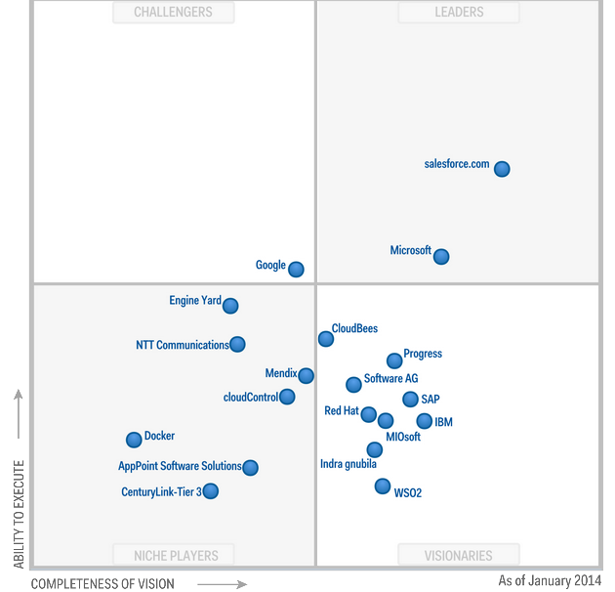
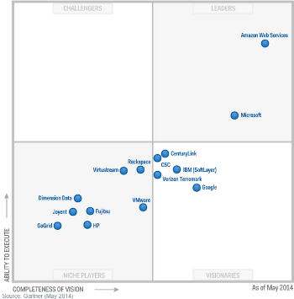
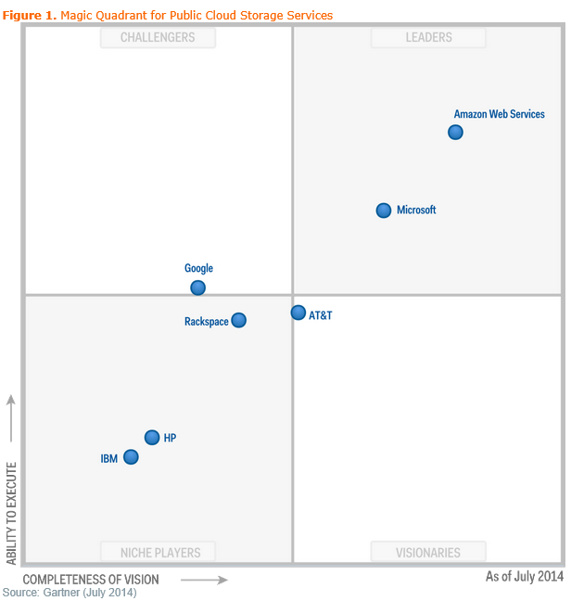
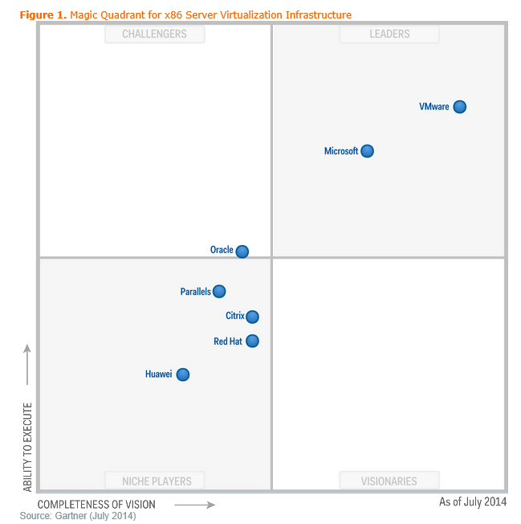
Market Endorsement
Gartner Magic Quadrant for Enterprise Application Platform as a Service(PaaS)
Gartner Magic Quadrant for Cloud Infrastructure as a Service(IaaS)
Gartner Magic Quadrant for Public Cloud Storage Services
Gartner Magic Quadrant for Virtualization

Slide 23
Store, backup, recover your data
1
Develop, test, run your apps
Develop, test, run your apps
Extend your infrastructure
Extend your infrastructure
Scenarios to get started with Microsoft Azure
Reach where your datacenter won’t
Reach where your datacenter won’t
Notes:
We’ll discuss 4 specific use cases and describe how you can bring Azure to your enterprise. In doing so, we’ll highlight key technologies and their benefits for you. You can talk about these at a very high level, or you can go into detail – at the end of the deck there are the details for each of these 4 sections…

Slide 24

© 2014 Microsoft Corporation. All rights reserved. Microsoft, Windows, and other product names are or may be registered trademarks and/or trademarks in the U.S. and/or other countries.
The information herein is for informational purposes only and represents the current view of Microsoft Corporation as of the date of this presentation. Because Microsoft must respond to changing market conditions, it should not be interpreted to be a commitment on the part of Microsoft, and Microsoft cannot guarantee the accuracy of any information provided after the date of this presentation. MICROSOFT MAKES NO WARRANTIES, EXPRESS, IMPLIED OR STATUTORY, AS TO THE INFORMATION IN THIS PRESENTATION.

Slide 25
Store, backup, recover your data
1
Develop, test, run your apps
Develop, test, run your apps
Extend your infrastructure
Extend your infrastructure
Scenarios to get started with Microsoft Azure
Reach where your datacenter won’t
Reach where your datacenter won’t
Notes:
We’ll discuss 4 specific use cases and describe how you can bring Azure to your enterprise. In doing so, we’ll highlight key technologies and their benefits for you. You can talk about these at a very high level, or you can go into detail – at the end of the deck there are the details for each of these 4 sections…

Slide 26
Store, backup, recover your data
Cloud Storage
Opportunity
Capacity
Data grows exponentially (50 – 60% Annually)
However most I/O happens to the “Working Set” data
Local Storage
SAN storage cost = 4x Cloud storage
(source: Forrester)
Time
Notes:
Store, Backup, Recover
Let’s first understand why Cloud makes for a great storage option? A typical organization increases their data storage by 50-60% every year (source:IDC). But only a small portion of the data is frequently accessed or used. So using purely on-premises storage like SAN/NAS solutions for that data is expensive. Forrester’s study placed a cost of about $95 per GB of data per year for an on-premises SAN solution which is 4X the cost of putting a GB in the Cloud. Of course, not all data can be put in the Cloud for performance or compliance reasons but where you can, using Azure for all backup and archived data, as well as less frequently accessed primary data makes a great business case.

Slide 27
Store, backup, recover your data
Azure Storage
10 Trillion Objects
“Azure Blob storage has taken a significant step ahead of last year’s leader Amazon S3, to take the top spot”
– Nasuni 2013 Cloud Storage Report
Notes:
Let us now understand the Windows Azure storage system and some of its salient features.
Treat Windows Azure as a giant “hard drive”. Why do we call it a giant? Windows Azure Storage has over 10 trillion objects, processes an average of 270,000 requests per second, and reaches peaks of 880k requests per second!
Windows Azure Blob storage is actually the top most rated by Nasuni Cloud storage report. This ranking is based on a number of factors like read/write speeds, availability and performance metrics.

Slide 28
Store, backup, recover your data
Microsoft Azure Storage
Highly durable and scalable
Multiple copies of your data
Financially backed SLAs
Storage for objects, tables, drives
Supports REST APIs
Notes:
We make 3 copies of data for durability and availability. So if a rack or server goes down, you data is available and accessible. We provide 99.9% SLA for storage.
Windows Azure Storage system is the underpinning to everything in Azure that requires storage. The Windows Azure storage system provides a solid robust data platform for different services that make use of it – Blobs, Tables and Drives.
Use Blob service for storing large amounts of unstructured data that can be accessed from anywhere in the world via HTTP or HTTPS. A single blob can be hundreds of gigabytes in size, and a single storage account can contain up to 100TB of blobs. Common uses of Blob storage include: Serving images or documents directly to a browser, Storing files for distributed access, Streaming video and audio, Performing secure backup and disaster recovery, Storing data for analysis by an on-premises or Windows Azure-hosted service
Tables is a NoSQL datastore which is ideal for storing structured, non-relational data. Common uses of the Table service include: Storing TBs of structured data capable of serving web scale applications, or storing datasets that don’t require a full fledged relational DB.
Drives are what are attached to VMs. They automatically provide get the same durability and availability. This differentiates us from other competitive offerings (like AWS) that have less reliable and durable storage systems for their VM instances.

Slide 29
Store, backup, recover your data
Microsoft Azure Storage
Defend against regional disasters.
East DC
> 400 miles
West DC
Geo replication
Notes:
Additionally, data is asynchronously copied to another datacenter that’s at least 400 miles away.
So you can be sure that every piece of data that you store in the Azure Blob is available as well as protected against regional disasters (we call this geo-replication).
Geo replication is a unique feature, that differentiates us from competition.

Slide 30
Store, backup, recover your data
Import/Export (preview)
Fast data transfer to Azure
Encrypted data transfer
Efficient recovery
Import service
COURIER SERVICE
Microsoft
Azure Blob Storage
HARD DRIVE
Customer
MS Regional Data center
Export service
Notes:
Typically large data sets take a very long time to upload or download over a network; For example, with a network 10 TB of data will take at least one month to upload over a T3 line. With Windows Azure import/export , this problem is eliminated. Import/Export enables you to move your large dataset to the Azure cloud more efficiently than over your network.
Similarly, you can use this service to export data that you need to recover: we download it at the Microsoft Regional Datacenters, and ship it back to you.
According to a recent survey, (source: Forrester) 49% of those surveyed plan to move their data or already have moved their data storage to the cloud, citing both cost reduction and flexibility as reasons to move storage into the cloud. 80% of IT decision makers in a recent study cited that encryption in transit was of critical or high importance. (source: Forrester)
A Forrester study also estimated a cost of about $95 per GB of data per year for an on-premises SAN solution which is 4X the cost of putting a GB of data into Azure.

Slide 31
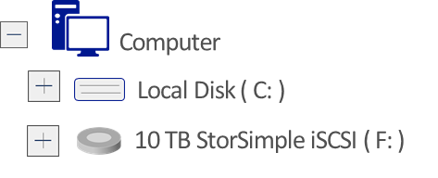

Store, backup, recover your data
Simple and fast on-ramp to Azure
Active data instantly available locally
Archives less used data to Windows Azure
Recover data from any internet connection
Reduce enterprise storage TCO by 60-80%
Physical or Virtual Servers
StorSimple
Your Data Center
Notes:
Azure Blob supports REST APIs so you can use it directly and build tools to integrate, but there are several ways you can use Windows Azure storage to integrate with your on-premises datacenter environment:
StorSimple Cloud-integrated Storage – StorSimple systems combine the data management functions of primary storage, backup, archive and disaster recovery with seamless Windows Azure integration – enabling a hybrid cloud storage solution through a single system and Windows Azure.
StorSimple systems use Windows Azure as an automated storage tier, offloading capacity management burdens and ongoing capital costs, while providing enterprise-grade local performance for active data sets. Using local and cloud snapshots, application-consistent backups complete in a fraction of the time needed by traditional backup systems while reducing the amount of data transferred and stored in the cloud.
Cloud-based and location-independent disaster recovery (DR) allows customers to recover their data from virtually any location with an Internet connection, and test their DR plans without impacting production systems and applications. Thin restore from data in the cloud enables users to resume operations after a disaster much faster than possible with physical tape, or cloud-based tape methods used with other cloud providers.
Customers benefit from significantly reducing their storage infrastructure sprawl, lowering total storage costs (TCO) by 60-80%, and simplifying data protection while rapidly accelerating data recovery times.

Slide 32


Store, backup, recover
Microsoft SQL Server
Backup and restore database to the cloud
Direct URL backup
to Azure Storage
Restore in Azure Virtual Machine
SQL Server Management Studio
Benefits
Reliable off-site data backup for SQL images
Easily restore databases using VMs
Notes:
Back Up and Restore of SQL Server Databases
The combination of Windows Azure Storage and Virtual Machines provides a great cost effective solution for backing up and restoring your on-premises SQL Server images. On-premises SQL Server images can be backed up asynchronously to Windows Azure Storage and in the case of an on-premises failure, the azure virtual machine can be quickly utilized to restore the image to reduce end user downtime.

Slide 33
Store, backup, recover your data
Microsoft Azure Backup
Backup datacenter data to Windows using System Center Data Protection Manager
Backup and recover files/folders from Windows Server 2012 SP1
Your On-Premises Datacenter
Windows Server 2012
Windows Server 2012 Essentials
Windows Server 2008 R2 (SP1)
System Center 2012 DPM SP1
Benefits
Reliable offsite data protection
Simple, familiar, integrated
Efficient backup and recovery
Easy set up
Notes:
While StorSimple solution we discussed earlier is more of an on-premises SAN solution that is integrated wit Windows Azure, you can also use Windows Azure directly for backups with Windows Server and System Center DPM.
Windows Azure Backup service extends Windows Server Backup, Essentials, or DPM with offsite backup to Windows Azure. You can backup server data to be backed up and recovered from the cloud in order to help protect against loss and corruption. Both Windows Server 2012 and System Center 2012 SP1 support this service. Here’s how you can use Windows Server and System Center with Windows Azure Online Backup:
Windows Server 2012 - Cloud-based backup from Windows Server 2012 is enabled by a downloadable agent that installs right alongside the familiar Windows Server backup interface. From this interface backup and recovery of files and folders is managed as usual but instead of utilizing local disk storage, the agent communicates with a Windows Azure service which creates the backups in Windows Azure storage.
System Center 2012 SP1
With the System Center 2012 SP1 release, the Data Protection Manager (DPM) component enables cloud-based backup of datacenter server data to Windows Azure storage. System Center 2012 SP1 administrators use the downloadable Windows Azure Online Backup agent to leverage their existing protection, recovery and monitoring workflows to seamlessly integrate cloud-based backups alongside their disk/tape based backups. DPM’s short term, local backup continues to offer quicker disk–based point recoveries when business demands it, while the Windows Azure backup provides the peace of mind & reduction in TCO that comes with offsite backups. In addition to files and folders, DPM also enables Virtual Machine backups to be stored in the cloud.
http://blogs.technet.com/b/server-cloud/archive/2012/09/07/windows-azure-online-backup.aspx
Benefits:
Reliable offsite data protection
Convenient offsite protection
Safe, geo-replicated data
Encrypted backups
A simple, integrated solution
Familiar interface
Protection for older servers
Windows Azure integration
Efficient backup & recovery
Efficient use of bandwidth and storage
Flexible recovery
Flexible configuration

Slide 34
Store, backup, recover your data
1
Store, backup, recover your data
Develop, test, run your apps
2
Develop, test, run your apps
Virtual datacenter
Extend your infrastructure
Scenarios to get started with Microsoft Azure
Reach where your datacenter can’t
Reach where your datacenter won’t

Slide 35
Develop, test, run your apps
Test and development on-premises
Limited hardware budget
Limited software licensing
Resource contention with VMs
Compromised developer agility
Realistic scale tests often challenging
Developers
Use VMs
Your Datacenter
Provision VMs
VMs in test/dev environment
IT Admin
Notes:
Test-drive your apps
Any organization that creates custom applications needs a dev & test environment. Developers need specific tools installed, while the test environment must replicate the world in which the new application will be deployed. Given the cost and time required to provision physical servers, it’s become common to use virtual machines to do this. So, given these are virtual machines on-premises anyway, why not use Windows Azure for this?

Slide 36
Develop, test, run your apps
Developers
Use VMs
Provision VMs
Test and development using Microsoft Azure
Cost effective (pay for what you use)
Improved developer agility with platform services
Ready to use gallery of images
Ship tested in realistic scale scenarios
Use existing development tools & languages
Access on-premise resources if necessary
Manage environment
IT Admin
Notes:
Here’s an easy way to do this - an IT administrator or a developer can use the Windows Azure Management Portal to create VMs in the cloud (step 1). Those VMs are created using Windows Azure Virtual Machines, the platform’s Infrastructure as a Service (IaaS) offering. Developers can supply their own VM images as ordinary VHDs or use VHDs provided by Windows Azure, with support for both Windows Server and Linux. Once the VMs exist, developers and testers can use them to build and test a new application, customizing the VMs as they see fit (step 2).
Why would you want to do this? Two main reasons - low cost and speed. Windows Azure VMs are available to their users in a few minutes, while deploying VMs in an organization’s own datacenter can take days or weeks. Also, an organization pays for public cloud VMs by the hour, at prices ranging from $0.02 to $1.10 per hour. This is relatively inexpensive, and the VMs can be shut down when they’re not in use, making them even cheaper.
Furthermore, with a gallery of images to readily choose from - like Windows Server, SQL Server, and various Linux distributions - your developers can quickly grab the images and start building or testing applications.
In addition to using VMs in Azure to build a test and dev environment, your developers can rapidly create apps using the various other services that would usually require time to set up on-premises. For example, there are ready- to-use-services in Windows Azure such as caching or NoSQL databases or SQL Database which are offered as services. Typically, if you had to setup a development environment on-premises, you’d need up servers for all of these and you’d need licenses. With Azure, you eliminate all of this and give your developers a developer friendly environment.
Benefits:
Deliver Faster. Agile development with no waiting for IT, new hardware, or availability of existing dev/test boxes.
Cost. Eliminate cap-ex expense and yet build test environments that scale better than ever.
Use Existing Tools. Continue using the development languages, tools and lifecycle technologies you are using today.
Test Better. Build bigger test environments that simulate real customer load including spikes without resource contention on the cloud’s “infinite” resources.
Leave Production Alone. Prevent dev/test apps from affecting on-premise production performance. Even virtualized on-premise test workloads can on-premise production on shared machines.
Access Existing Resources - Securely network from the cloud to on-premise to test against systems of record if necessary.
Deploy Anywhere with No Lock-in. Once testing deploy either in the cloud or on-premise

Slide 37
Develop, test, run your apps
Start VMs and app development in Azure
Deploy anywhere with no lock-in
Your Datacenter,
or Your Hoster
Easy VM portability
If it runs on Hyper-V, it runs in Microsoft Azure
Production environment
Notes:
Once everything is developed and tested, you o course have the choice of running in Azure or bringing it back to production environment on your premises.
If that’s the case, moving the deployment is easy. Because Windows Azure VMs use the exact same format as the Windows Server Hyper-V i.e. VHD. So if it runs on Hyper-V it runs in Azure and vice-versa. In fact, Windows Azure is built on the same foundation as Windows Server 2012!
This is unique for us. Other public cloud vendors will convert the image into proprietary formats and it becomes hard to convert back.
If you have your on-premises environment on a different platform other than Hyper-V, the Microsoft Virtual Machine Converter (MVMC) Solution Accelerator is a Microsoft-supported, stand-alone solution to convert VMware-based virtual machines and disks to Hyper-V®-based virtual machines and disks.
How about management? While you can use the Windows Azure management portal, you can also use the familiar System Center 2012 management console. System Center 2012 introduced the App Controller component to enable organizations to optimize resource usage across their private cloud and Windows Azure resources from a single pane of glass. In SP1, we’ve extended App Controller’s capabilities to integrate with Windows Azure Virtual Machines enabling you to migrate on-premises Virtual Machines to run in Windows Azure and manage them from your on-premises System Center installation.

Slide 38

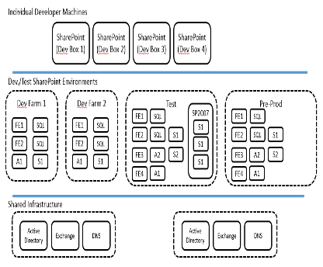
“We needed to take a new approach and Microsoft Azure Virtual Machines provided the right solution for our business.”
– Andreas Hogberg, Telenor
Challenges
Benefits
Move from SharePoint 2007 to SharePoint 2013 across 18 different business units, spread across 12 countries
Quickly create a large SharePoint farm for Dev/test within time and cost limits
Limitless resources for Dev/Test
Speed: Build a SharePoint farm in days not weeks
Low cost, scale up and down as needed
Familiar tools and automation via PowerShell
Portability: On-premises or at Hoster as needed

Slide 39
Store, backup, recover
Store, backup, recover your data
Develop, test, run your apps
2
Develop, test, run your apps
Extend your infrastructure
3
Extend your infrastructure
Scenarios to get started with Microsoft Azure
Reach where your datacenter can’t
Reach where your datacenter won’t

Slide 40

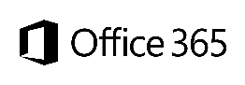
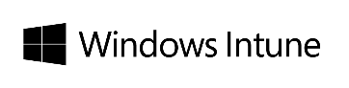



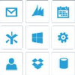
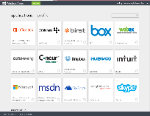
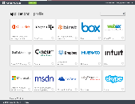
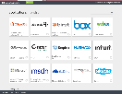
Identity as the control point
Microsoft apps
Active Directory
Azure Active Directory
Custom LOB apps
ISV/CSV apps
3rd party clouds/hosting
PCs and devices
Consumer identity providers
Notes:
An average user already deals with a bunch of usernames and passwords for his on-premises applications, and [Click] cloud based applications are piling up with an increasing pace. There are already enterprises that have many cloud based applications in their environment. (There are more than 20.000 SaaS apps in the market already according to IDC)
Huge amounts of money have been invested in on premises identity and access management solution without actually having the problem of Single Sign On solved. Help centers and IT departments all over the world can confirm that.
If you add personal cloud applications' identities into the mix along with the desire to access applications from different devices, you get many frustrated users who voice their unhappiness and place pressure on IT for simpler solutions.
The challenge for IT in today’s world of many devices, on premises apps, cloud apps, and hybrid apps is that they are not always aware of all the cloud-based applications their users are accessing. IT has not purchased or deployed these apps and in most cases they have no visibility into how they were purchased or if they are being managed. With the dramatic increase in cloud applications and the ease of sign up and free trials, Management and users are asking from IT departments to provide single sign on from everywhere to everything…
A solution to this problem could be a federation with each and every one of those cloud-based applications. But not all of them are using the same protocols or standards when it comes to identity management, which can make federation a very difficult task.
Instead, organizations need a hub that can sync their on-premises Active Directory, seamlessly connect with many cloud applications, can integrate with various protocols and can scale around the globe to authenticate users everywhere from any device in a way that integrates simply with their existing identities. With more than 95% of fortune 1000 organizations using Windows Server Active Directory on premise, they would prefer not to reinvent the wheel or recreate all of their identities. The good news is that they don’t have to.
That’s exactly what Windows Azure Active Directory provides. And it does that in a secure and comprehensive manner.
Multi0factor authentication can provide an additional way to increase access protection even more

Slide 41
Extend your infrastructure
Microsoft Azure Infrastructure Services
Microsoft Azure Virtual Network
Logical isolation with control over network
Create Subnets, Private IP addresses
Bring your own DNS
<subnet 1>
<subnet 2>
<subnet 3>
DNS Server
Virtual Network
Notes:
Extend your Datacenter
Own the base, rent the rest! Extend your datacenter by building capacity on-demand.
With Windows Azure, you can literally create a virtual “datacenter” in the Cloud. You can do this by leveraging a feature called Virtual Network (VNET) which allows you to create a logically isolated section of Azure and treat it like your own network. You can customize the network configuration for a VNET - create subnets, assign private IP addresses and bring your own DNS server if you wish. Within a virtual network for example, you can create a public-facing subnet for your webservers that has access to the Internet, and place your backend systems such as databases or application servers in a private-facing subnet with no Internet access.

Slide 42
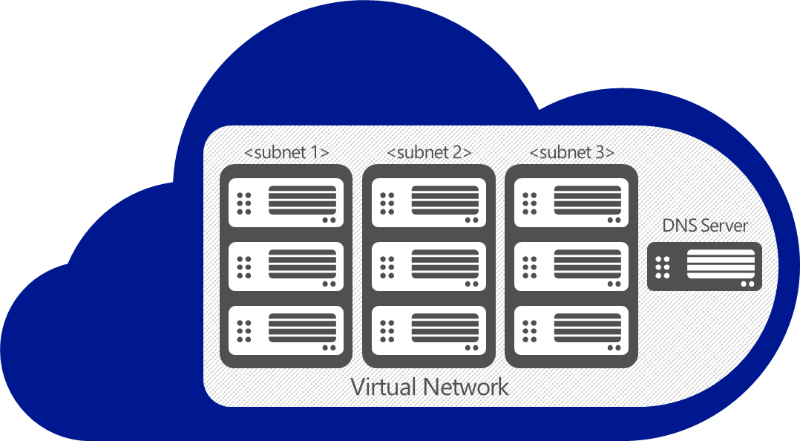
Extend your infrastructure
Microsoft Azure Infrastructure Services
Virtual Network as your Datacenter extension
Create Subnets, Private IP addresses
Bring your own DNS
Domain join your VMs
VPN
Customer datacenter
VPN
Notes:
Of course, once you set up VPN connectivity, you’re treating the virtual network in Azure almost as if it were an extension of your on-prem datacenter. You can domain join your VMs with an AD running on-premises or an AD running inside of the virtual network. You can have hybrid multi-tier apps with perhaps the presentation and logic tiers running in Azure, and the database tier running on-premises for compliance reasons.
A good example is SharePoint that uses all of the features we outlined (cross-premises VPN connectivity, Active Directory, VMs).
Windows Azure provides first party tested Windows Server images for easily deploying SharePoint, SQL and Active Directory.
<From IaaS scenario for Sharepoint>
When you need more from your collaboration infrastructure vs. Office 365 and the ability scale in real time, count on Windows Azure. Start with dev & test work and maintain control as you grow. You can deeply customize with full trust custom code on top of Windows Azure infrastructure services. Support provided directly by Microsoft.
Internet sites with SharePoint: When you need to roll-out customized public or anonymous internet sites, count on Windows Azure. You can closely manage your infrastructure versus Office 365 and get real time scalable resources vs. on-premises datacenters. Get started quickly with direct Microsoft supported images.
<From IaaS scenario for AD>
Identity with AD in Virtual Machines
Hybrid apps and hybrid IT: When apps live both in the cloud and on-premises, and need to synch with on-premises directory, simply bring DirSync into Virtual Machines.
Specific AD capabilities in the cloud: When applications in need of on-premises optimized AD capabilities are moving to cloud and Windows Azure Active Directory is not the solution, bring your AD into Virtual Machines. Same AD, same skill sets and same trustworthy capabilities.
Identity synch with Office 365: When you need to synch identity with O365 and want to minimize your on premise identity infrastructure, rely on running AD in Virtual Machines. Even when you have an on-premises identity infrastructure synching with Office 365, simply build your high availability copy in Virtual Machines and keep working when internet connectivity is down.
<From IaaS scenario for Scalable, On-Demand Infrastructure For .NET apps>
When you need to accommodate variable and increasing needs of .NET and Windows Server apps, spin up trustworthy infrastructure with no code changes required. And, it is more than just infrastructure. Use Windows Azure building blocks – such as Service Bus or Media Services and many more from partners in Windows Azure Store – to boost your existing app.
When you want to participate in software as a service business model as an app vendor and host all or part of an existing .NET or Windows Server app in the cloud with no changes, build your offer on scalable, trustworthy Windows Azure infrastructure.

Slide 43
Extend your infrastructure
Securely connect to Virtual Network from anywhere
Uses VPN client in Windows OS
Traverses firewalls and proxies
Microsoft Azure datacenter
Site-to-Site VPN
Customer datacenter
VPN
VPN
Point-to-Site VPN
Individual computers behind corporate firewall
Remote workers
Notes:
Let’s say you have individual PCs behind the firewall that you want to connect directly to Azure—or that you have remote workers. You can connect securely to the virtual network In Azure from anywhere using the VPN client in Windows. Because it works across firewalls and proxies, it doesn’t matter if users are behind your firewall, behind someone else’s firewall, or are remote.

Slide 44

Extend your infrastructure
Private network connectivity
Private, secure, fast connectivity (Coming soon)
Microsoft Azure as a node on customers MPLS VPN
Directly connect to Windows Azure at peering exchange location
Public Internet
Microsoft Azure datacenter
Customer datacenter
Customer WAN
VPN
VPN
Carrier-provided MPLS
(AT&T)
Peering exchange location
(Equinix)
Notes:
What you saw previously was how you set up a hybrid connectivity between on-premises and Windows Azure over the public Internet. While easy and quick to set up, there are some limitations to using the internet—things like limited bandwith or latencies, or corporate policies that require require higher levels of security than traffic traveling over the public internet (even if its encrypted).
We’re working on a set of technologies that will provide you private connections with Windows Azure. There are two types of private connectivity:
The ability to add Windows Azure to a carrier-provided MPLS network: We announced a partnership with AT&T, which will allow customers to seamlessly add Azure resources to existing MPLS VPNs provided by AT&T.
The ability to connect with Azure datacenters at peering exchange locations globally. We have partnered with Equinix, whichcan provide cross-connects between the customer's network and Azure.
We’re working on both options now, and are onboarding a limited number of customers before the end of 2013. We expect the solution to be ready for general availability in H1 2014.

Slide 45


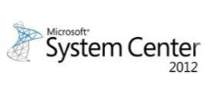
Extend your infrastructure
Use scalable on-demand virtual machines in Microsoft Azure for:
Microsoft apps - SharePoint, SQL, Biztalk, Active Directory
3rd party apps – Oracle, Linux
Apps with public web front ends or DMZ
Apps with variable traffic, spiky workloads
Development & Test environments
Microsoft
Azure
Active Directory
SharePoint
SQL Server
Consistent virtualization platform across Hyper-V and Microsoft Azure
Customer datacenter
VHD
Manage both your datacenter and Windows Azure with System Center 2012
Notes:
So what can you do with a hybrid cloud? Here are some examples of what you can look forward to.

Slide 46
Store, backup, recover your data
Store, backup, recover your data
Test drive your apps
Develop, test, run your apps
3
Extend your infrastructure
Extend your infrastructure
Scenarios to get started with Microsoft Azure
Reach where your datacenter won’t
4
Reach where your datacenter won’t

Slide 47
Reach where your datacenter won’t
Websites with global reach
Build websites with global scale
Built-in support for open web frameworks
Managed by Microsoft
Improve performance with Traffic Manager
Microsoft Azure Websites
Notes:
Reach where your datacenter can’t
Use Windows Azure for global reach and scale. So far, we discussed ways in which you can use Windows Azure in conjunction with your datacenter. But your datacenter has limits. So why not rely on Windows Azure to reach where your datacenter can’t.
Let’s take a few examples:
Web Sites with global reach
Let’s take the example of a typical organization where marketing folks would want to rapidly develop, run and the shutdown marketing campaigns. It’s likely that capacity requirements for these are not known ahead of time, and these websites are less likely to have compliance issues. In fact, enterprises that run these are most likely running them already in the DMZ portion of their datacenters. Windows Azure makes for a great platform for developing and deploying these types of sites.
Your developers quickly and easily build and deploy sites to a highly scalable cloud environment that allows them to start small and scale as traffic grows. Whether it’s a .NET app development or using an open framework like WordPress or Joomla, your developers get an out-of-the box experience.
Furthermore, Windows Azure is able to do global load balancing through service called Traffic Manager. Using this service to serve users from around the globe. Traffic Manager allows you to load balance incoming traffic across multiple apps whether they’re running in the same datacenter or across different datacenters around the world. Traffic Manager provides you a choice of three load balancing methods: performance, failover, or round robin. So, if you have a global ad campaign running, you can make sure that the site that serves a user in Singapore is running out of the Azure datacenter in Asia whereas the site running in a US datacenter is serving the user located in US. By effectively managing traffic, you can ensure high performance, availability and resiliency of your applications.

Slide 48


Reach where your datacenter won’t
Azure Mobile Services Turnkey backend for Mobile apps
Extend internal web apps to mobile devices
Quickly build and deploy consumer facing apps
Land your app on any platform or device
data
auth
push
Notes:
Mobile apps
Another use case is to use the Cloud like a “mother ship” with which mobiles and tablets can hook up for computing resources.
With Windows Azure Mobile Services, you can streamline common development tasks like structuring storage, integrating push notifications and configuring user authentication. Mobile Services fully supports Windows Store, Windows Phone 8, iOS, Android and HTML5 development.
Windows Azure Mobile Services makes it faster and easier to build dynamic mobile apps that scale. Mobile Services streamlines common development tasks like storing data in the cloud, authenticating users, and sending push notifications. We take care of the infrastructure so you can focus on what matters—user experience.
-Extend internal web apps to mobile devices: With an increasingly mobile workforce, your employees need to be able to both access and interact with important internal applications from any device. With Mobile Services, you can extend internal web apps to a variety of mobile devices and enable your workforce to stay connected no matter where they are. You can deliver that experience even if you have sensitive data that needs to stay on-premises behind a firewall.
-Quickly build and deploy consumer facing apps: Mobile Services supplies the infrastructure you need to stand up a consumer facing mobile app in minutes. You can also easily work with your favorite APIs like Twilio for adding voice/SMS or SendGrid for sending email to further accelerate development.
-Land your app on any platform or device: Mobile Services provides out of the box support for iOS, Android, Windows Store, Windows Phone 8, HTML5, and Windows Phone 7 apps. We give you the choice of developing native apps using the SDK for each platform, mobile web apps that run on any platform, or using Xamarin.iOS and Xamarin.Android to write native apps for iOS and Android in C#.

Slide 49
Reach where your datacenter won’t
Partner integration
Integrate with partner IT systems
Use a highly available, scalable messaging infrastructure with ServiceBus and Biztalk services
Notes:
Partner integration
Another scenario is to use Windows Azure as a common meeting place or a messaging hub for integrating IT systems. WHY would you use Azure for this? Availability and Scale. A conduit or an integrations point for IT systems has high requirements for availability and scale. And it must work across systems behind several firewalls.
Windows Azure has integration capabilities to connect your systems and your partner systems, or end point devices through a feature called Service Bus. Service Bus is messaging infrastructure that sits between applications allowing them to exchange messages in a loosely coupled way for improved scale and resiliency. In addition, Windows Azure has EAI capabilities for accessing your on-premises line of business applications like SAP and Oracle EBS

Slide 50

Power your business with Microsoft Azure
© 2013 Microsoft Corporation. All rights reserved. Microsoft, Windows, Windows Vista and other product names are or may be registered trademarks and/or trademarks in the U.S. and/or other countries.
The information herein is for informational purposes only and represents the current view of Microsoft Corporation as of the date of this presentation. Because Microsoft must respond to changing market conditions, it should not be interpreted to be a commitment on the part of Microsoft, and Microsoft cannot guarantee the accuracy of any information provided after the date of this presentation. MICROSOFT MAKES NO WARRANTIES, EXPRESS, IMPLIED OR STATUTORY, AS TO THE INFORMATION IN THIS PRESENTATION.

Slide 51

“Because management time and cost is so low with Microsoft Azure, we focus on growing the business, not on managing red tape. It’s important for us to be able to say that VAS is supported by Microsoft Azure, prospective customers don’t have to worry that their service is running on some anonymous group of servers or at a hoster. “
William K. Smyth - Global Business Manager, 3M VAS
Challenges
Benefits
3M is one of the largest manufacturers in the world but, when it comes to launching new businesses, it scrutinizes startup costs as closely as any entrepreneur.
Maximize IT agility and cost effectiveness of new ventures
Needed platform that would provide fast application response time
Minimizes Internal Management Time, Cost., and hardware acquisition
Revenue boosted by 50%
Accelerated application response time by 2-3 seconds
Familiar development environment allows for easy ramp to the cloud
Microsoft manages the platform, 3m grows their business
Notes:
3M is one of the largest manufacturers in the world but, when it comes to launching new businesses, it scrutinizes startup costs as closely as any entrepreneur. That’s why 3M chose to host its new Visual Attention Service on Windows Azure. Because subscription costs are “negligible” and managers avoid the administration associated with hardware acquisition, those managers can focus on growing their business—and have boosted revenue by 50 percent.
3M, long ensconced at the highest echelons of the global elite, has global IT networks to support its US$29.6 billion in annual revenues. Still, it wants to maximize IT agility and cost-effectiveness, especially from its new ventures. One such venture—think of it as an internal startup—is the 3M Visual Attention Service (VAS), begun three years ago. The business unit grew out of corporate research into how the brain processes visual information. Using 3M-developed proprietary algorithms, the unit has the ability to show its customers how their customers will look at marketing materials: what spots they’ll look at, for how long, and in what order. That’s crucial information for refining web pages, ads, posters, video, and any other visual marketing material for maximum impact and return on investment.
The initial deployment of VAS focused on a single web interface, supported by three Windows Azure instances, through which 3M customers uploaded their designs and received analyses in 15 to 20 seconds. Today, 12 Windows Azure instances—needed to support the steadily growing demand—support not just the web interface, but also phone apps, a Photoshop plug-in, and clients created through third-party software development kits. Total application response time—including the time for a customer to upload its design, for the VAS application to analyze it, and for the customer to receive its analysis—has accelerated to 2-to-3 seconds.
Benefits
Minimizes Internal Management Time, Cost
Familiar Dev tools – Visual Studio
Spurs 50 Percent Revenue Growth
Instills Customer Confidence – partnership with Microsoft
Uses:
Windows Azure
Microsoft SQL Azure
Microsoft Visual Studio

Slide 52




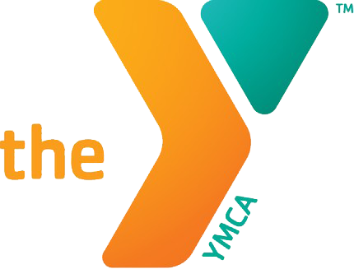


“We have customers in 60 countries around the world that need access to our business operations applications. They need to be trained and have immediate access. Microsoft Azure allows us to do offer that at instant scale.”
– Don Noonan, Blackbaud
Challenges
Benefits
Nonprofits in 60 countries
Schools and churches to hospitals and charities, rely on Blackbaud's nonprofit software to help them achieve their missions.
With Windows Azure IaaS they run their business operations software AND train customers at non-profits on how to use it.
An instant training environment for customers
Affordable solution that scales up and down with needs
SQL Server backend that supports application data
Notes:
Blackbaud is the largest Nonprofits in 60 countries, from schools and churches to hospitals and charities, have relied on Blackbaud's nonprofit software to help them achieve their missions. We bring together nonprofit technology and expertise to help organizations change the world. Over 27,000 Nonprofits Rely on Blackbaud to Raise Money, Manage Funds and Run Their Operations
They use IaaS with Windows Azure to host a number of their business operations tools. They also use it for distance Learning – their program that allows non profits to enter, spin up a VM, get trained and spin the Vm down. No travel and easy training for customers.
Systems on iaaS:
“Distance Learning” – Solutions
The Raiser's Edge
The Financial Edge
The Education Edge
Blackbaud for Small Schools
Student Information System
Blackbaud NetCommunity
Friends Asking Friends
Grow
Spark
Blackbaud Direct Marketing
Altru
Blackbaud CRM
Research Point

Slide 53


“We specifically chose Microsoft Azure over other cloud providers. The tools to be able to quickly build and deploy are a huge benefit. We are extensively using Infrastructure Services and Platform Services with Microsoft Azure and the combination fits our needs perfectly. It allows us to focus on serving our customers.
Jagdash Rajan
SVP, Technology, Digital Air Strike
Challenges
Benefits
GM wanted an integrated social and email feedback system for their dealers collecting information to and from multiple social and dealer sites and on premise data systems. A fully transparent process that allows instant communication and feedback for dealers from their customers.
Digital Air Strike built them a system that allows for integration of social feeds, an email feedback responses system and immediate information for dealers and consumers.
.
PaaS + IaaS allows for managing where you want to, and allowing Microsoft Azure to manage the rest
Familiar tools like PowerShell, and Visual Studio
Ability to instantly scale storage from large data sources at a significantly lower cost
Ease of development with shorter time to market
Notes:
Build. Learn. Test. – Embrace Rapid Innovation Using Cloud Labs for Dev & Test
The first scenario we’ll review is one that applies broadly to every type of organization. Whether you’re a developer and a CEO – at the same time - in a one-person startup getting your mobile app out the door, or a multi-national enterprise with 100,000 employees, you need a sandbox to build, test and learn. And you need a safe, isolated zone to do it.
You can count on Windows Azure Infrastructure Services to quickly standup labs for testing and developing apps, validating app behavior, and creating presales, training, and teaching environments. Provisioning Virtual Machines in minutes gives you access to a sandbox and a lab. Most dev, test and lab environments are project-based and don’t need to be up and running 24x7. When you’re done, simply turn your virtual machines off. You pay for what you use and no more.
Let’s do the simple math. You have to pay at least $3000K USD just for the most basic hardware box. Then, you need to acquire and pay for the O/S license to run on top of it, and the cost to power and cool that box. Instead, get a single small standard Windows Azure Virtual Machine; run it 24x7. You pay about $83 USD per month. Get three, you pay about $250 per month. That includes the O/S and the power and the cooling. Say your project lasts six months, you are at about $1500 per month. [I AM WARY OF THIS ROUGH COMPARISON, WE KEEP SAYING THIS IS NOT FOR COST REASONS AND YET WE MAKE IT SO BLACK AND WHITE COST COMPARISON. PLUS A LOT COMES INTO PLAY IN COMPARISON OF HARDWARE , SPECS FOR SPEED AND MEMORY. I THINK WE SHOULD STAY AWAY]
Do you have server boxes under your developers’ desks where they create build environments and mimic production servers? Let Windows Azure Virtual Machines handle that for you - quickly. That server box under the desk does not need to run 24x7, be maintained all year long and refreshed every three years. Get access to pre-built Windows Server and many other Microsoft workload images in the gallery, pick from the open source community VM Depot or bring a VHD image of your own.
Are you upgrading a line of business application to Windows Server 2012 and need to stress test your stack top to bottom? You can grow or shrink your sandbox and application load in real-time in Virtual Machines. You get to stress your application load and infrastructure capacity in order to mitigate issues before they begin. When you’re done, move to on-premises or simply connect to on-premises via a virtual network.
Do you have customer support teams that need to re-produce errors reported by internal and external clients in order to resolve app problems? Does your sales team need to demo an app running at scale on Suse Enterprise Linux in front of a customer? Do you need to build a prototype of a SharePoint site before you bid for a new project? You don’t have to dedicate on-premises hardware for these if you don’t choose to; and you don’t need to acquire new hardware if you’re short on time or budget. This is where Windows Azure Infrastructure Services comes through.
Yet, it’s not just about replicating infrastructure. Your developers need tools to work, too.
Sometimes it is about building new rich apps and reducing developer cycle times. When you want to reduce dependencies of your developer teams on IT operations for rolling-out test environments, consider running Team Foundation Server (TFS) in Virtual Machines. You can roll out farms on-demand and continue to access TFS from on-premises installed tools such as Visual Studio, Microsoft Test Manager and browser apps. Testers in your team also can configure and manage test labs using TFS Test Lab Management quickly. <if TFS falls through, have to remove>
Or, when you want to collaborate with development partners who don’t have access to your corpnet, TFS in Virtual Machines provides the right infrastructure.

Slide 54

RadioShack wanted to enhance its capacity to deliver product-availability information and promotional coupons to its customers and sales partners. The retailer worked with Pariveda Solutions to develop store locator, inventory, and coupon management solutions based on Microsoft Azure.
As a result, RadioShack upgraded its marketing infrastructure, reduced costs, built better partnerships, enhanced customer satisfaction, and increased their revenue.
Notes:
RadioShack wanted to enhance its capacity to deliver product-availability information and promotional coupons to its customers and sales partners. The retailer worked with Pariveda Solutions to develop store locator, inventory, and coupon management solutions based on Windows Azure. As a result, RadioShack upgraded its marketing infrastructure, reduced costs, built better partnerships, enhanced customer satisfaction, and increased revenue.
To provide customers and partners with store location and inventory information, RadioShack used a number of online mechanisms, but the company had challenges communicating real-time inventory visibility. “RadioShack does business through multiple channels, so it’s very important for us to deliver real-time product-availability data,” says Dan Buckley, Senior Director of IT at RadioShack. “But historically, we could only provide inventory visibility from close of business the previous day.”
RadioShack had to involve multiple internal and third-party business teams, and significant engagement from its IT department. It could take close to a day just to generate the coupon codes. RadioShack wanted to create an automated coupon solution that would support the creation, delivery, validation, and redemption of coupon offers through stores, franchises, and partner-managed sales channels.
“We needed a solution that would enhance our capacity to deliver rich product and promotional content to our customers and sales partners,” says Buckley.
Benefits:
RadioShack used Windows Azure to build a coupon system that is simpler, faster, more accurate, and less expensive. Marketing teams can create up to 1 million coupon codes in just 30 minutes, without having to engage the IT team. Individual stores and marketing partners can get up-to-the-minute product availability data when they need it, without hard-to-manage VPN connections.
“Instead of spending up to 80 hours helping a partner integrate with our network, my IT team can help them connect to our Windows Azure environment in a couple of hours,” says Buckley.
Technology
Windows Azure Access Control Service
Windows Azure Blob Storage
Windows Azure Service Bus Relay

